Slide 1
UCM102: Introduction to Information and Communication Technology
Lecturer : Dr. UWITONZE Alfred
Cell phone : 0788549588
E-mail : alfruwitonze@gmail.com

Slide 2
Course outline
Chapter 1: Introduction to Computers
Chapter 2: Operating Systems
Chapter 3: Binary and Decimal Number Systems
Chapter 4: Internet Applications
Chapter 5: Introduction to Computer Security
Chapter 6: Microsoft Office Word 2007
Chapter 7: Microsoft Office Excel 2007
Chapter 8: Microsoft Office PowerPoint 2007

Slide 3
Chapter 3: Binary and decimal Number systems
Binary Numbers
Computers only understand the binary number system.
Bit
A binary digit is called a bit. Usually, 0 and 1 the two numbers of the binary numbering system.
A bit is the smallest unit of information a computer can use.

Slide 4
Binary and decimal systems
A 16 bit computer would process a series of 16 bits, such as 0100111101011000 in one go, repeating the process thousands or millions of times per second.
Byte
A group of 8 bits is called a byte (B in short).
One byte can store one alphabetical letter, single digit, or a single character/symbol, such as #. Large numbers of bytes can be expressed by kilobyte and megabyte

Slide 5
Binary and decimal systems
Kilobyte
The value of a kilobyte is 1024.
Worked out as 2^¹⁰. Normally Kilo refers to 1000 but in computing kilobyte is 1024.
Megabyte
Likewise, 1024KB is referred to as a "Megabyte". Normally a Mega refers to a million. In computing 1 Mega byte is 1,048,576 bytes. Worked out as 2^^{20, or} 1024*1024.

Slide 6
Binary and decimal systems
1 byte of memory can normally hold one of the following:
  A single alphabetical letter (upper or lower case),
  A single number 0-9
  A symbol ( _ + £ # > etc)

Slide 7
Binary and decimal systems
DECIMAL SYSTEM
To learn binary system, we first need to understand how number systems operate.
Let's take a look at the decimal system first, since it is simple and easier to think about.
We can consider the number "1234" as,
Thousands | Hundreds | Tens | Ones
1 | 2 | 3 | 4

Slide 8
Binary and decimal systems
DECIMAL SYSTEM
Which means, 1234 = 1x1000 + 2x100 + 3x10 + 4x1
Given,
1000 | = 10^3 = 10x10x10
100 | = 10^2 = 10x10
10 | = 10^1 = 10
1 | = 10^0 (any number to the exponent zero is one, except for zero).

Slide 9
Binary and decimal systems
DECIMAL SYSTEM
The table above can be represented as,
such that,
1234 = 1x1000 + 2x100 + 3x10 + 4x1
= 1x10^3 + 2x10^2 + 3x10^1 + 4x10^0
Thousands | Hundreds | Tens | Ones
10^3 | 10^2 | 10^1 | 10^0
1 | 2 | 3 | 4

Slide 10
Binary and decimal systems
DECIMAL SYSTEM
The decimal system, as with decimal math, operates in "base 10" (dec being the Latin prefix for ten) using the digits 0-9 to represent numbers, whereas the binary system, as well as its math, operates in "base 2" (bi being the Latin prefix for two) using the digits 0-1 to represent numbers.
The base is also known as the radix. In other words, the table above can be represented as,

Slide 11
Binary and decimal systems
DECIMAL SYSTEM
 | Thousands | Hundreds | Tens | Ones
Decimal | 10^3 | 10^2 | 10^1 | 10^0
Binary | 2^3 | 2^2 | 2^1 | 2^0

Slide 12
Binary and decimal systems
DECIMAL SYSTEM
Let’s use the number 256 as another example.
The most important calculation to do is to work out the positional values for that system.
The positional value is based on the powers of the number systems base value.

Slide 13
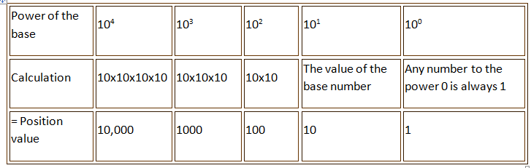
Binary and decimal systems
DECIMAL SYSTEM

Slide 14
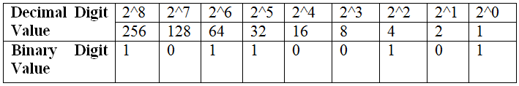
Binary and decimal systems
Converting Decimal number into Binary number
N = 6163₁₀ (Six Thousand One Hundred and Sixty Three) is equal to:
(6×10³) + (1×10²) + (6×10¹) + (3×10⁰) = 6163
Convert 357 into binary

Slide 15
Binary and decimal systems
Converting Decimal number into Binary number
Adding together the value of all the "1" s gives us: (256) + (64) + (32) + (4) + (1) = 357₁₀
Then, the number 101100101₂ in binary is equivalent to 357₁₀ in decimal or denary.
Another method of converting decimal into binary number equivalents is to write down the decimal number and to continually divide by 2 (two) to give a result and a remainder of either a "1" or a "0" until the final result equals zero.

Slide 16
Binary and decimal systems
Converting Decimal number into Binary number
Example: Convert the decimal number 294₁₀ into its binary number equivalent.

Slide 17
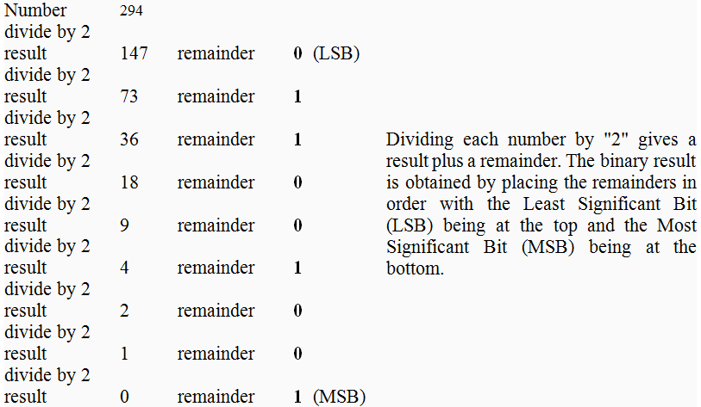
Binary and decimal systems
Converting Decimal number into Binary number

Slide 18
Binary and decimal systems
Converting Decimal number into Binary number
Then, the Decimal number 294₁₀ is equivalent to 100100110₂ in Binary format.

Slide 19
Binary and decimal systems
Exercises
1. Convert the following decimal numbers to binary numbers:
1073, 508, 403, 278, 180
2. Convert the following binary numbers to decimal numbers:
11110_{2,} 1111_{2,} 1110110_{2,} 1110101_{2,} 110011001₂

Slide 20
Binary arithmetic
Arithmetic in binary is much like arithmetic in other numeral systems.
Addition, subtraction, multiplication, and division can be performed on binary numerals.

Slide 21
Binary arithmetic
Addition
The simplest arithmetic operation in binary is addition.
Adding two single-digit binary numbers is relatively simple, using a form of carrying:
0 + 0 → 0
0 + 1 → 1
1 + 0 → 1
1 + 1 → 0, carry 1

Slide 22
Binary arithmetic
Addition
Adding two "1" digits produces a digit "0", while 1 will have to be added to the next column. This is similar to what happens in decimal when certain single-digit numbers are added together; if the result equals or exceeds the value of the radix (10), the digit to the left is incremented:
5 + 5 → 0, carry 1 (since 5 + 5 = 0 + 1 × 10)
7 + 9 → 6, carry 1 (since 7 + 9 = 6 + 1 × 10)

Slide 23
Binary arithmetic
Addition
This is known as carrying. When the result of an addition exceeds the value of a digit, the procedure is to "carry" the excess amount divided by the radix (that is, 10/10) to the left, adding it to the next positional value.
This is correct since the next position has a weight that is higher by a factor equal to the radix.
Carrying works the same way in binary:

Slide 24
Binary arithmetic
Addition
1 1 1 1 1 (carried digits)
0 1 1 0 1
+ 1 0 1 1 1
-------------
=1 0 0 1 0 0
In this example, two numerals are being added together: 01101₂ (13₁₀) and 10111₂ (23₁₀).

Slide 25
Binary arithmetic
Addition
The top row shows the carry bits used. Starting in the rightmost column, 1 + 1 = 10₂.
The 1 is carried to the left, and the 0 is written at the bottom of the rightmost column.
The second column from the right is added:
1 + 0 + 1 = 10₂ again; the 1 is carried, and 0 is written at the bottom.
The third column: 1 + 1 + 1 = 11₂.

Slide 26

Binary arithmetic
Addition
This time, a 1 is carried, and a 1 is written in the bottom row. Proceeding like this gives the final answer 100100₂ (36 decimal).
Another example:

Slide 27
Binary arithmetic
Subtraction
Subtraction works in much the same way:
0 − 0 → 0
0 − 1 → 1, borrow 1
1 − 0 → 1
1 − 1 → 0

Slide 28
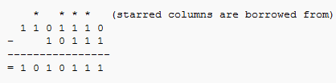
Binary arithmetic
Subtraction
Example:

Slide 29
Binary arithmetic
Multiplication
Multiplication in binary is similar to its decimal counterpart. Two numbers A and B can be multiplied by partial products: for each digit in B, the product of that digit in A is calculated and written on a new line, shifted leftward so that its rightmost digit lines up with the digit in B that was used.
The sum of all these partial products gives the final result.

Slide 30
Binary arithmetic
Multiplication
Since there are only two digits in binary, there are only two possible outcomes of each partial multiplication:
If the digit in B is 0, the partial product is also 0
If the digit in B is 1, the partial product is equal to A

Slide 31
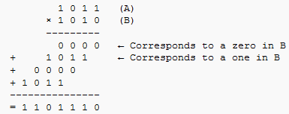
Binary arithmetic
Multiplication
For example, the binary numbers 1011 and 1010 are multiplied as follows:

Slide 32
Binary arithmetic
Division
Binary division is again similar to its decimal counterpart:
Here, the divisor is 101₂, or 5 decimal, while the dividend is 11011₂, or 27 decimal.
The procedure is the same as that of decimal long division; here, the divisor 101₂ goes into the first three digits 110₂ of the dividend one time, so a "1" is written on the top line.

Slide 33
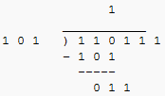
Binary arithmetic
Division
This result is multiplied by the divisor, and subtracted from the first three digits of the dividend; the next digit (a "1") is included to obtain a new three-digit sequence:

Slide 34
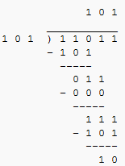
Binary arithmetic
Division
The procedure is then repeated with the new sequence, continuing until the digits in the dividend have been exhausted:

Slide 35
Binary arithmetic
Exercises
Perform the following binary arithmetic operations:
11101 + 1010 =
11111 + 11111 =
1101 - 11 =
10001 - 100 =

Slide 36
Binary arithmetic
Exercises
Perform the following binary arithmetic operations:
1011 x 11 =
11011 x 101 =
1010 / 100 =
10111 / 10 =

Slide 37
Binary Number Names
Binary numbers can be combined into one of several size ranges depending upon the number of bits being used and are generally referred to by the following more common names of:
Number of Binary Digits (bits) | Common Name
1 | Bit
8 | Byte
16 | Word

Slide 38
Binary Number Names
Most computer hardware such as hard drives and memory modules commonly indicate their size in Megabytes or even Gigabytes.
Number of Bytes | Common Name
2¹⁰=1,024 | Kilobyte (KB)
2²⁰=1,048,576 | Megabyte (MB)
2³⁰ =1,073,741,824 | Gigabyte (GB)
2⁴⁰ which is a very long number! | Terabyte (TB)

Slide 39
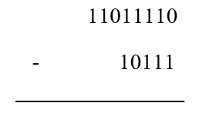
GROUP ASSIGNMENT 1 /10 Marks
1. Justify the importance of internet for a student.
2. Complete the following: 147,456 bits=…………Bytes= ……… KB=…………MB
3. Convert in binary number system the following decimal number: 294
4. Convert in decimal number system the following binary number: 1011101011
5. Do the following operation in binary number systems:

Slide 40
END OF CHAPTER 3!!!

